Slide 1

CivicsPolitical Capstone
Introduction
The Question
Why?
Data Source
Methodology
Tools
Analysis
Aida, Joseph, Liza, and Irina

Slide 2
THE QUESTION
Do social characteristics and behavior predict presidential voter choice?

Slide 3

WHY?
Introduction
The Question
Why?
Data Source
Methodology
Tools
Analysis
In a politically polarized American society, understanding underlying drivers for political decisions may reduce existing tensions and contribute to a more balanced and cooperative political culture.
Notes:
We selected this topic because in a politically polarized society, understanding underlying drivers for political decisions may be useful in bringing about a more balanced and cooperative political culture.

Slide 4
DATA SOURCE
Introduction
The Question
Why?
Data Source
Methodology
Tools
Analysis
Shiro Kuriwaki
Cooperative Congressional Election Study (CCES)
Dataframe (452,755 observations, 73 features)
Geographic, demographic, economic, news interest, political affinity, and presidential choice variables
One of the most comprehensive political surveys in the US
Notes:
Kuriwaki, Shiro complied voter survey data in .Rds file format for the years 2006–2018. The dataframe contains 452,755 rows (observations) and 73 columns (features), including geographic, demographic, economic, news interest, political affinity, and presidential choice variables.
The data was drawn from Cooperative Congressional Election Study (CCES), one of the most comprehensive political surveys in the US.

Slide 5
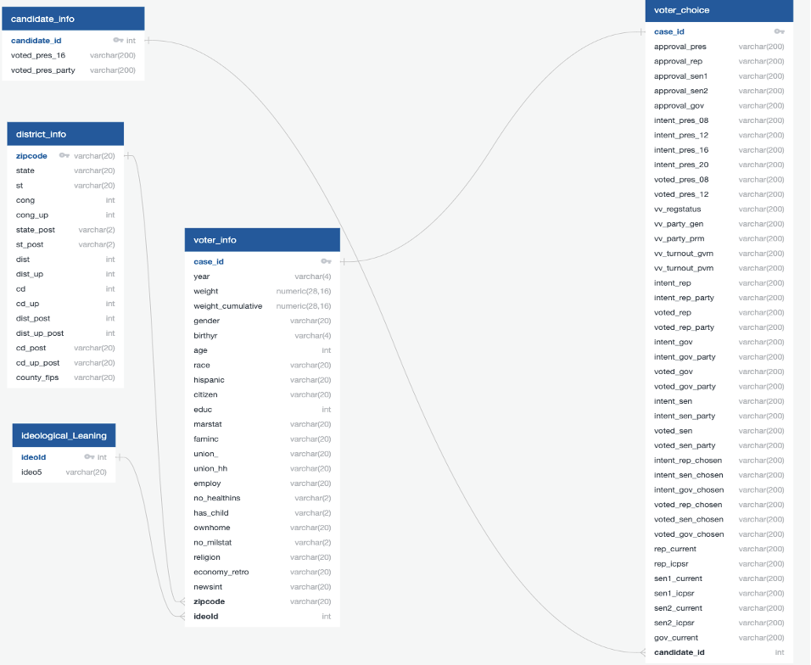
DATABASE
Introduction
The Question
Why
Data Source
Methodology
Tools
Analysis
Notes:
The data set is divided into 5 CSV files and from each of them has been created a separate table in Postgres DB:
candidate_info, district_info, ideological_leaning, voter_info, voter_choice

Slide 6
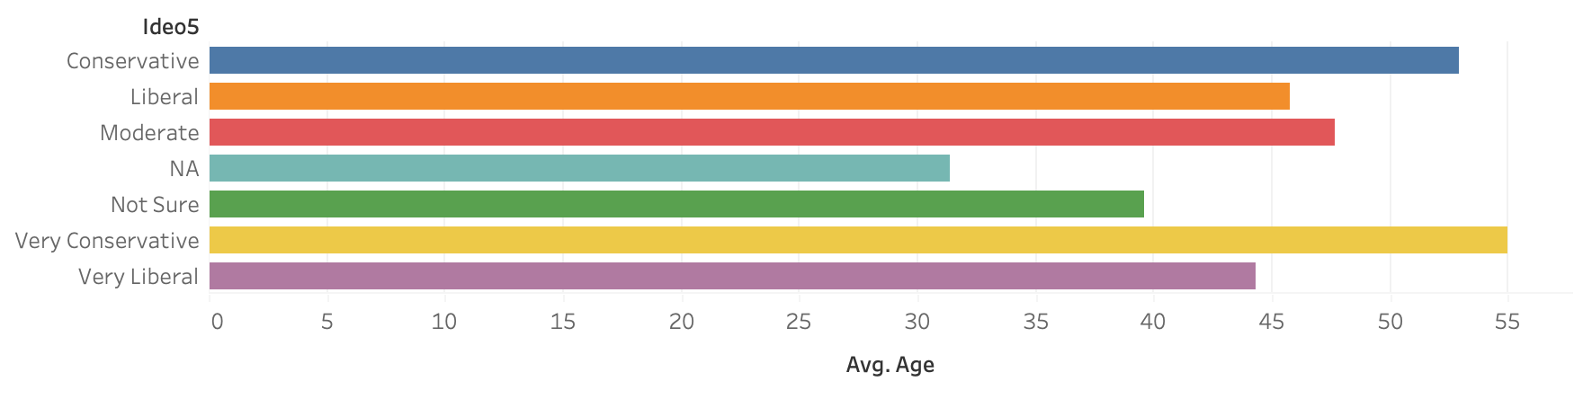
Visualization
Introduction
The Question
Why?
Data Source
Methodology
Tools
Analysis

Slide 7
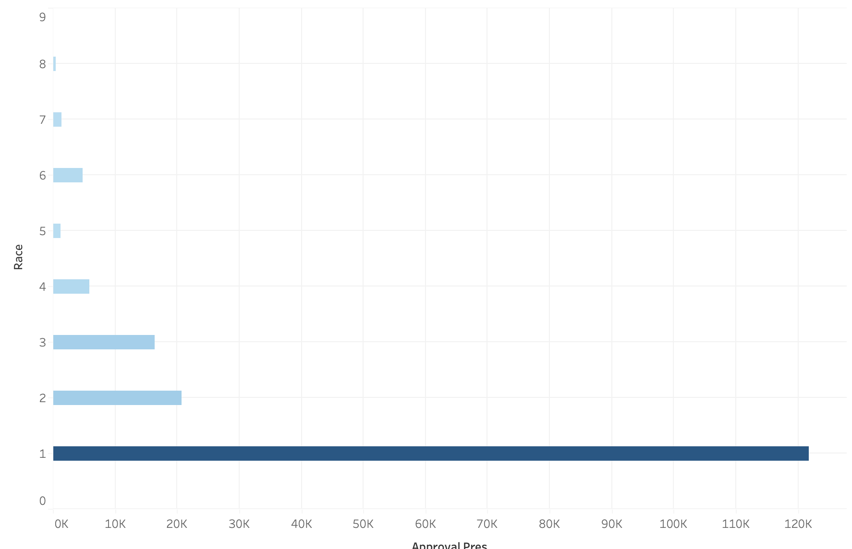
Visualization
Introduction
The Question
Why?
Data Source
Methodology
Tools
Analysis

Slide 8
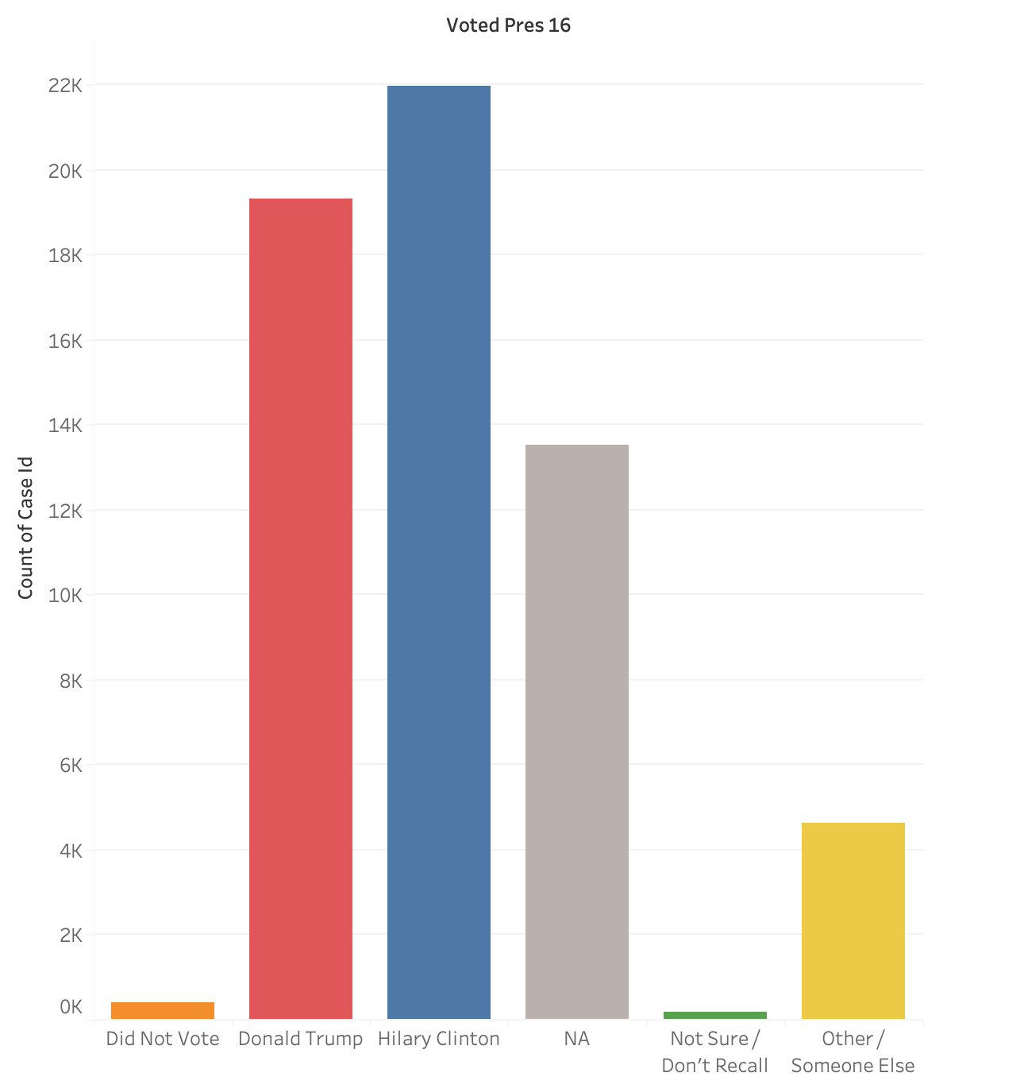
Visualization
Introduction
The Question
Why?
Data Source
Methodology
Tools
Analysis

Slide 9
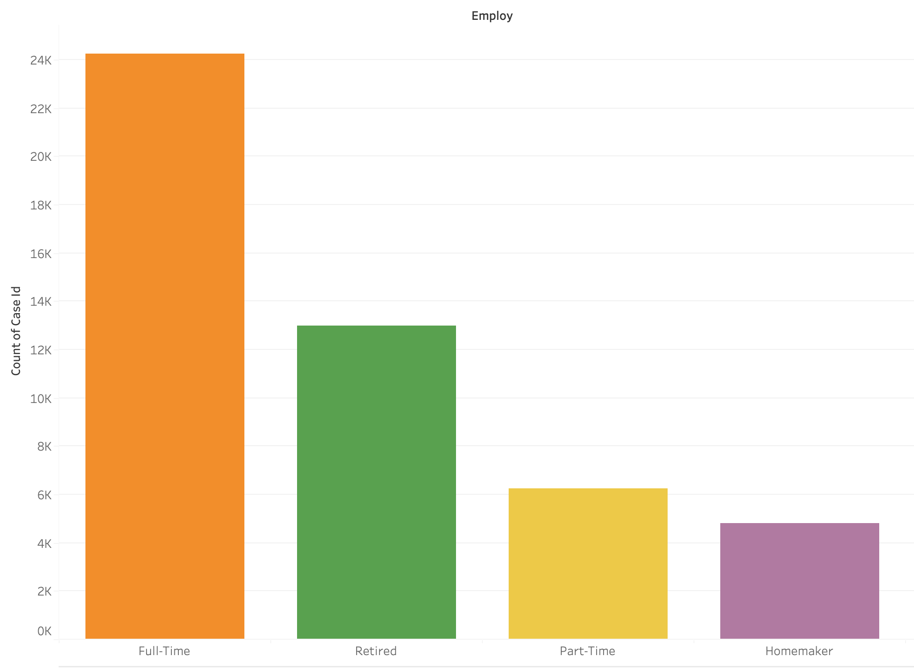
Visualization
Introduction
The Question
Why?
Data Source
Methodology
Tools
Analysis

Slide 10





TOOLS - Technologies, Languages, and Algorithms Used
Github
Python
R
Jupyter Notebook
Algorithms
Lots of coffee
Introduction
The Question
Why?
Data Source
Methodology
Tools
Analysis
Tableau
Storage and display
Analysis
Analysis
Visualization
Analysis
Keras, ReLu, softmax, adam, crossentropy, neural network
Energy

Slide 11
METHODOLOGY - Data Exploration
Introduction
The Question
Why
Data Source
Methodology
Tools
Analysis
Refine the data for the most recent survey year (2018)
Use R and translate the data in Python for the purpose of using Jupyter
Use machine learning to develop a predictive model for presidential choice
Divide 80% of the data into a “training" section
Use the remaining 20% for the “test” section of data
Notes:
Data Exploration and preprocessing:
We will refine the data for the most recent survey year of 2018, which holds 60,000 rows and 93 features. The data pertains to voter information, ideological leaning, voter opinion, and candidate information. For the machine learning model, we will be using the following features in a dataframe:
State, district, cong., geography, gender, birthyear, age, education, race, family income, marital status, news interests, ideology, and presidential vote for 2016. Since the database contains a lot of features with categorical data, then one-hot encode those variables into dummy sets (Using the dummy_cols and fastDummies packages).
After the features have been given a numeric value, the output features which is the 2016 presidential vote will be removed from the dataframe. The data is separated into training and test sets, the model is then trained.
For the input layer of the model, the activation function is ReLu (Rectified Linear Unit) since this is a category classification, it will be comprised of 148 variables fed to a neuron. For the hidden layer the activation function that was used is softmax. For compiling and training the model, the optimizer algorithm used is adam and the loss function that is used is sparse categorical crossentropy. The model will also have 20% of its training data for the model to iteratively calculate validation errors. 500 epochs are chosen for lastly the algorithm will stop if the test model performance doesn’t increase for 20 continuous epochs. The output layer will consist of five categories (in accordance with the survey question structure): voted Trump, voted Hillary Clinton, Voted Other, Did not Vote, and Not Sure/Don't Recall.

Slide 12
Neural Network
Introduction
The Question
Why
Data Source
Methodology
Tools
Analysis
The preferred modeling technique for data science, machine learning, and predictions.
PROS
Are flexible and can be used for both regression and classification problems
Are good to model with nonlinear data with large number of inputs
It works by splitting the problem of classification into a layered network of simpler elements. Once trained, the predictions are pretty fast.
Can be trained with any number of inputs and layers.
They work best with many data points
CONS
Are black boxes, meaning we cannot know how much each independent variable is influencing the dependent variables.
It is computationally very expensive and time consuming to train with traditional CPUs.
They depend a lot on training data which leads to the problem of over fitting and generalization.

Slide 13
METHODOLOGY - Data Exploration
Introduction
The Question
Why
Data Source
Methodology
Tools
Analysis
Input layer using ReLu - 148 variables fed to a neuron. These neurons will connect to a 100-neuron hidden layer
Hidden layer using softmax, optimizer algorithm adam, and loss function sparse categorical crossentropy
Output layer will consist of five categories: voted Trump, voted Hillary Clinton, Voted Other, Did not Vote, and Not Sure/Don't Recall
Notes:
For the input layer of the model, the activation function is ReLu (Rectified Linear Unit) since this is a category classification, it will be comprised of 148 variables fed to a neuron. For the hidden layer the activation function that was used is softmax. For compiling and training the model, the optimizer algorithm used is adam and the loss function that is used is sparse categorical crossentropy. The model will also have 20% of its training data for the model to iteratively calculate validation errors. 500 epochs are chosen for lastly the algorithm will stop if the test model performance doesn’t increase for 20 continuous epochs. The output layer will consist of five categories (in accordance with the survey question structure): voted Trump, voted Hillary Clinton, Voted Other, Did not Vote, and Not Sure/Don't Recall.

